Slide 1
Banking App Simulator:
49er Credit Union
Levi Carpenter and Amanda Poteate

Slide 2

Elevator Pitch
Introductions: Amanda and Levi
University of NC, Charlotte
Overall Goal: providing transparent, convenient remote banking
Product: Banking App Simulator
Notes:
Hey guys, my name Is Amanda and this is my teammate Levi. We are Computer Science students at UNC Charlotte. The overall goal my team is hoping to address with our product is providing transparent, easy-to-understand, reliable banking to all. We decided to do this with a baking app simulator.

Slide 3

Elevator Pitch
Progressing technology requires innovation and consumer ease
Crucial for finances!
Current global state calls for remote handling of many life tasks
Banks are essential business
Remote banking should be easy for everyone
Particularly true for high-risk individuals, like the elderly
Notes:
In the technological world we live in today, everything is constantly changing. In this constant change, we want to know the tech we use is easy to understand and quick to learn. I think we can all agree this is especially important when it comes to our money!
Most importantly is the urgency for such tech resources, particularly in this time of pandemic where it is safer to handle everything we can in self-isolation. We need to be able to operate somewhat normal life functions – the need for remote handling is stronger than ever.

Slide 4

Elevator Pitch
Problem: lack of easy-to-use banking applications that cater to all ages and people
Solution: release a simulation that provides foundations for any banking app starter
Both account holders and employees
Age, technological experience, location
Notes:
The problem my team and I are attempting to resolve is a lack of easy-to-use applications for banking. The applications we already use tend to be slightly confusing and can be slow to learn for those with less technological experience. After all, bank visits typically just consist of filling out a slip of paper and chatting with a teller.
After analyzing the banking apps that my team and I use in conjunction with in-person bank visits, we aim to release a simulation that can provide foundations for any banking app starter – this is our solution. We wish to provide a banking application that is simply set-up and easy for both account holder and bank employee to use - regardless of age or experience with technology.

Slide 5

Elevator Pitch
Design Goals:
Easy functions (conspicuous menus/buttons)
Logical layout
Easy-to-read (font, color, size)
Concise handling of information in database
Notes:
Some primary design goals for our app are easy-to-follow functions (like menus and buttons) and a logical setup. Keeping the app simple and easy-to-read (in terms of coloring, font, size among other things) is also important.

Slide 6

Elevator Pitch
Benefits:
Safety and security for users
Improve remote services
Make room for inexperienced tech users
Ease of use
Notes:
Benefits of a banking app that eliminates confusion would include helping users feel safer and more secure in handling their money remotely. It could also improve remote banking services for elderly and those who aren’t as adept with technology. In times when technology is becoming ever more beneficial to staying connected from afar, it is ever more important to be sure anyone and everyone can use it.

Slide 7
Design

Slide 8
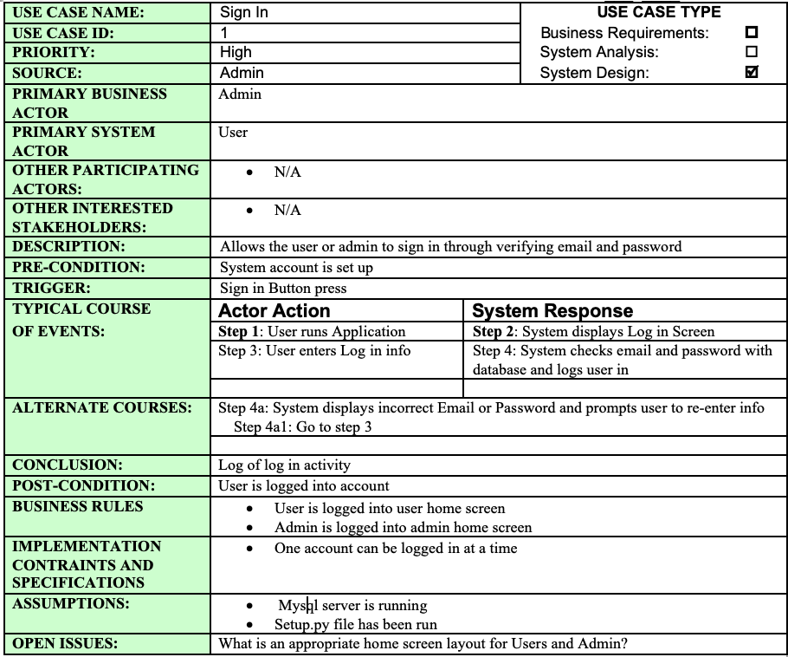
Use Case:
Sign in

Slide 9
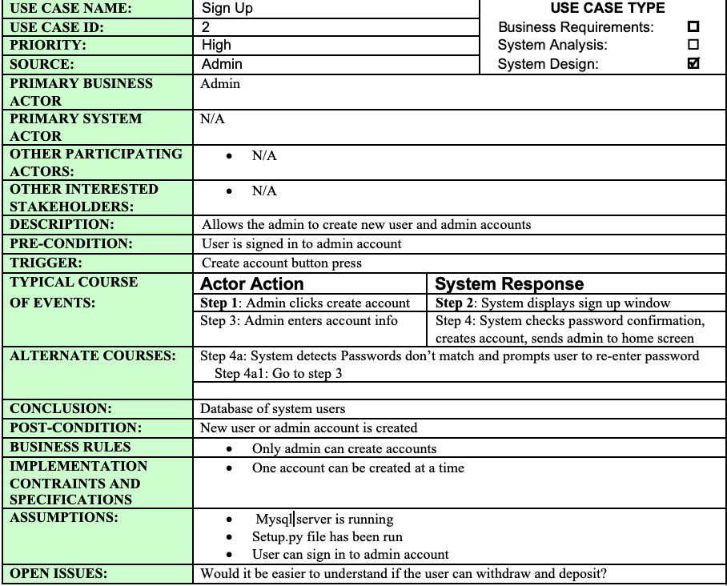
Use Case:
Sign Up

Slide 10
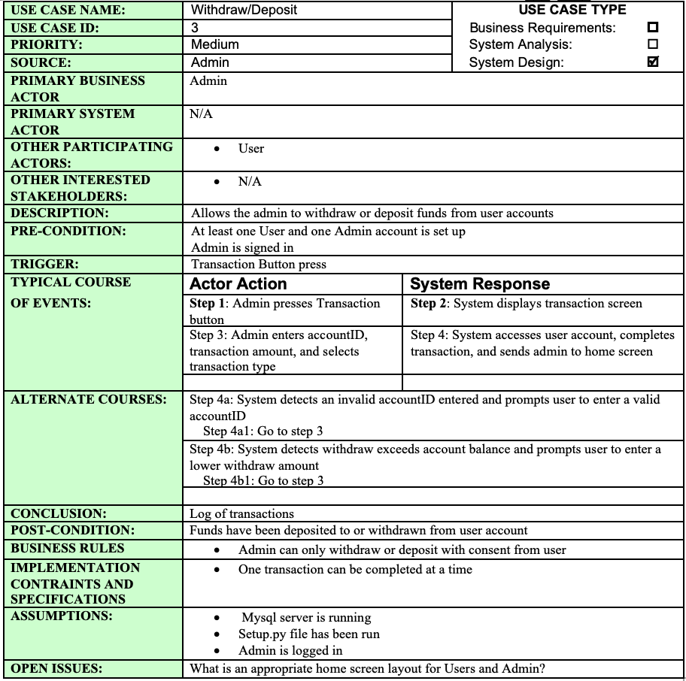
Use Case:
Withdraw/Deposit

Slide 11
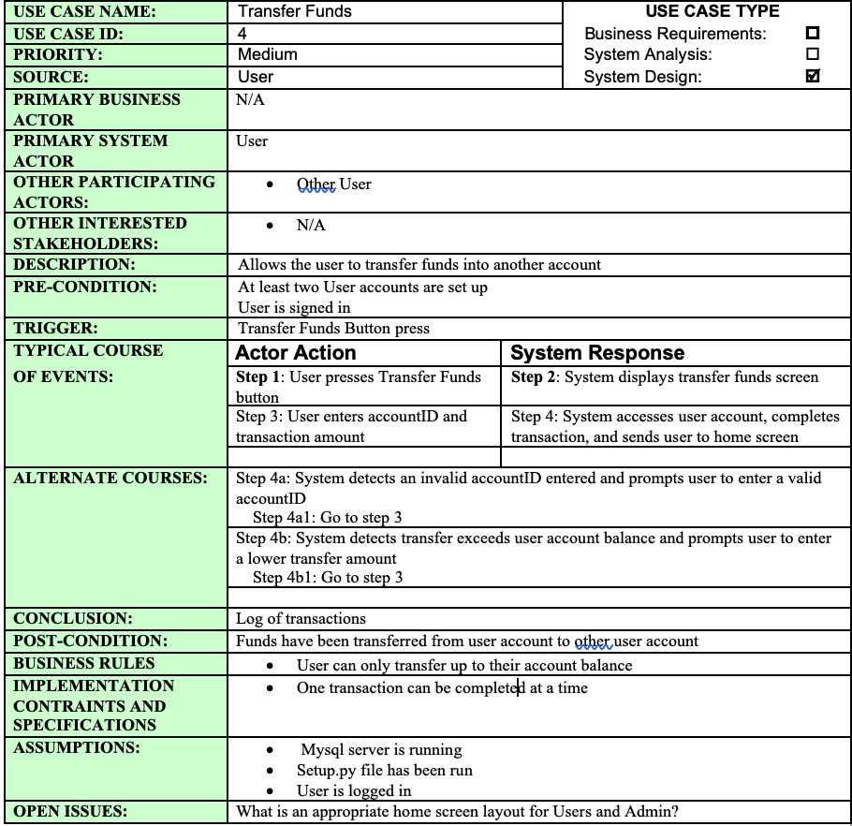
Use Case:
Transfer Funds

Slide 12
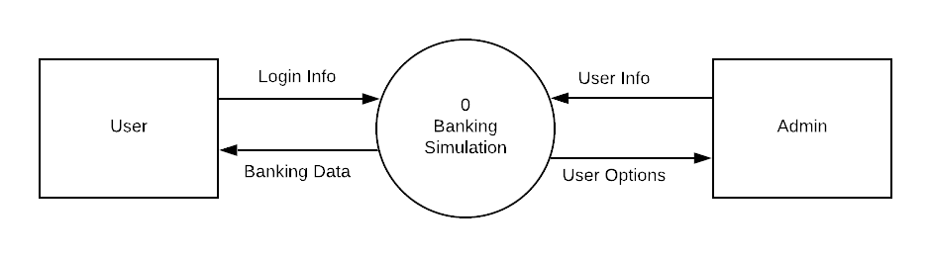
Context Diagram

Slide 13
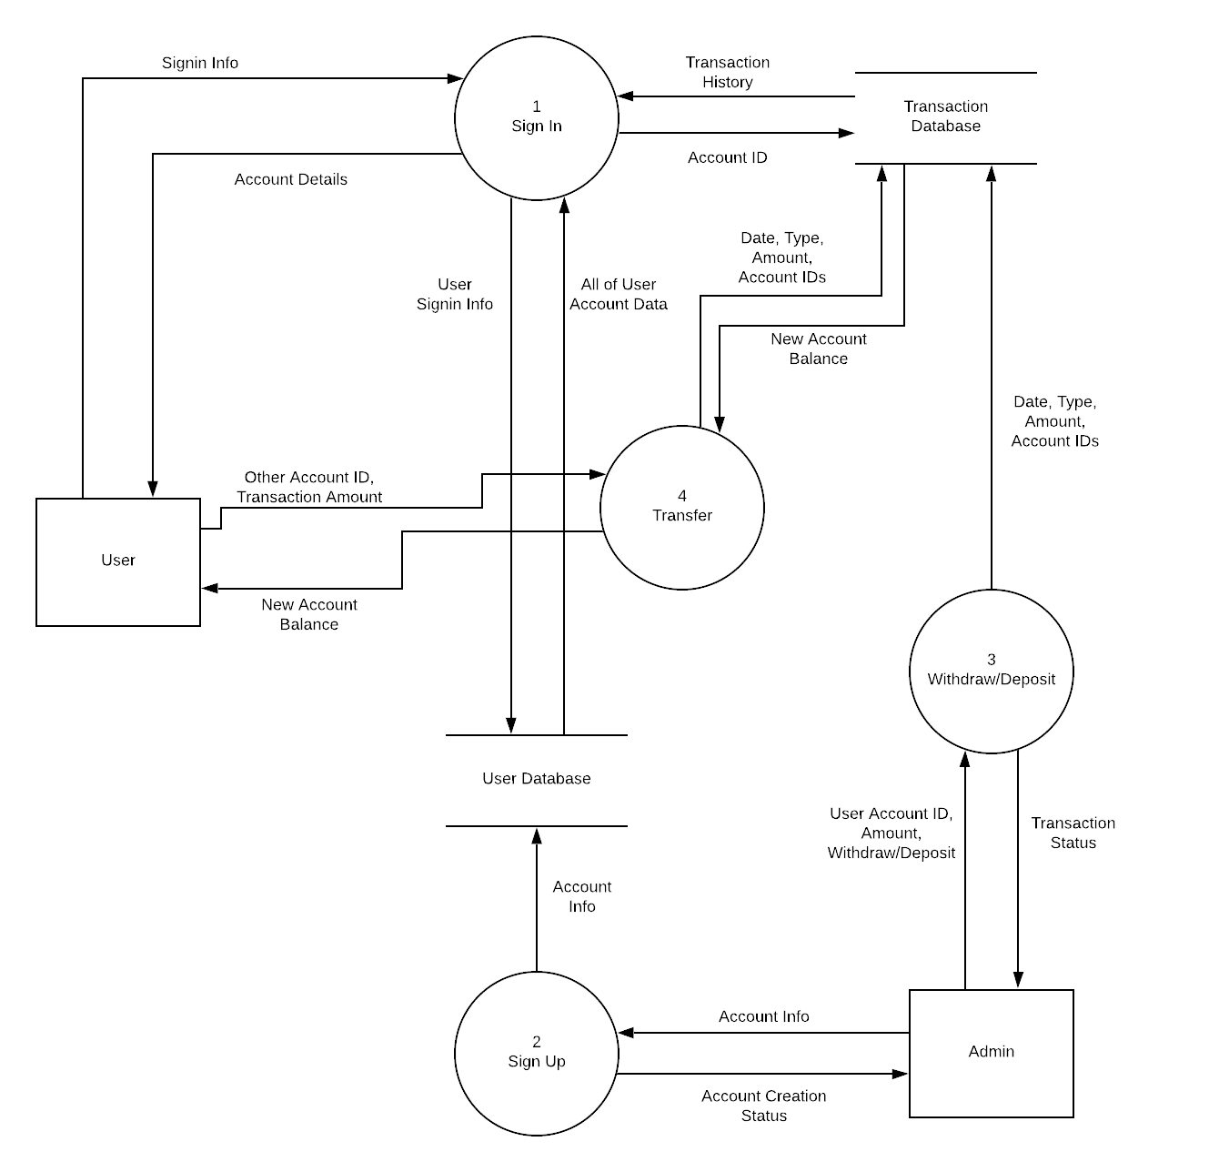
DFD

Slide 14
How it was created

Slide 15
Structure - Design Side
Files
Setup.py
Initialize SQL Database
Simulator.py
Main
Admin.py
Access admin functions
User.py
Access user functions
Transaction.py
Stores transaction data

Slide 16
Structure - Design Side
Setup.py
Creates database and tables
Tables
User
Transaction
Creates root admin
Creates user for test cases

Slide 17
Structure - Design Side
Simulator.py
Uses tkinter and mysql-connector
Handles GUI
Display
Transition
Creates instance of user at sign in
Gathers inputs
Checks for errors

Slide 18
Structure - Design Side
Admin.py
Holds admin details from database
Performs user actions
Withdraw
Deposit
User.py
Holds user details from database
Creates log of transactions for specific user
Updates balance
Transactions.py
Holds details from any transaction
Updates database
Displays transaction info as string
Notes:
Amanda - explain each class and what they do

Slide 19
Structure - User Side
User options
Admin
Withdraw/Deposit
Create Account
User
View Balance
View Transaction History
Transfer Funds
Notes:
Amanda - go through user options and how this relates to actual banking application usages today

Slide 20
Challenges
Choosing GUI implementation
Learning mysql-connector and Tkinter
Accessing SQL queries in python
Storing transaction history
Scheduling and completing tasks according to such
Trial and error with user-friendly formatting
Personal opinion vs mass satisfaction
Notes:
Levi - describe and explain first 4 challenges
Amanda - last 2 challenges involving scrum meetings, scheduling, planning, milestones, etc and determining what is the most user friendly layout

Slide 21
Demo

